Slide 1
Competition Policy and Economic Development – is there a link for Small Economies?
Slides accompanying lecture at the Fair Trading Commission of Barbados
John Davies

Slide 2
competition policy and small country development
Immediate economic benefits of actions by competition authorities
Deterrent effects of existence of competition authority
Longer term economic benefits: productivity growth
Broader economic benefits: the social dimension
Some (additional) small country considerations
(time permitting) – the international dimension. What outlook for competitive markets in the world of Trump and Brexit?

Slide 3
1 & 2 – immediate effects and deterrence

Slide 4
Direct benefits of competition enforcement the scale of the problem
Collusive cartels are the most obvious and direct cost of anti-competitive behaviour – there are some very precise numbers but only for the cartels we have discovered:
  On average 1990 – 2013, discovered international cartels affected US$750bn commerce per year, overcharge 40% (Connor, 2014)
  In 1997 developing countries imported US$54.7bn of goods from industries containing a price fixing conspiracy, representing 5.2% of total imports (Levenstein, Suslow and Oswald 2003)
  A dataset of 249 ‘hard-core’ discovered cartels within developing countries affected sales relating to about 4% of GDP. As well as higher prices, the cartels reduced production by about 15% in each affected market (Ivaldi, Khimich and Jenny 2014)
How many cartels were not discovered? No one really knows, but economists estimate between 15 – 25% or so. So the true cost will be about 4 – 6 X higher.

Slide 5
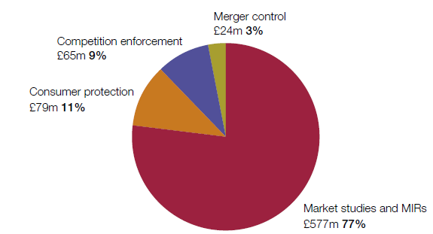
Direct benefits to consumers
Competition agency measures of ‘impact’
Some authorities attempt to estimate overall ‘impact assessments’ of their interventions
EU DG Competition equivalent exercise found EUR7 - 10 billion just for enforcement . More competition authorities are doing this, eg Lithuania estimates 9:1 ratio, Hungary 4:1.
OECD has produced a template.
UK CMA 2012 – 2015 average annual savings to consumers:
Total £744m = US$923m, about 11 x annual cost of the agency
However, these measures are very simplistic and undoubtedly underestimate the benefit: deterrence, broader competition policy, productivity…?

Slide 6

Deterring anti-competitive behaviour:
The vitamins cartel
International cartel (producers in OECD countries) 1989 – 1998, total overcharges about US$5bn in today’s prices
Evenett and Clarke (2002) estimated overcharges in 92 countries, 23 of them in LAC
Overcharges systematically higher in countries without effective competition law and institutions to enforce it.
  Barbados not included, but taking the average of Costa Rica, Dominican Republic and Trinidad & Tobago, overcharge in Barbados would have been about US$2.2m in the absence of a competition authority.
  If a competition authority had existed, overcharge would have been US$0.7 – 1.4 million – saving US$0.8 to US$1.5 million
  I note the FTC budget is around $3.7m = US$1.7m annually.

Slide 7
Effects of broader competition policy
Cheaper public procurement
Winning bids for one pharmaceutical product, IMSS Mexico
Collusion between bidders
IMSS consolidates purchases, attracts new bidder
Other bidders adjust, start competing
This single change saved an estimated EUR 250m.
Overall, IMSS estimated savings at EUR 700m/year

Slide 8
Effects of broader competition policy advocacy for reduced regulatory barriers
Issue | Annual Benefit | Number of provisions affected | Value, €m
“Fresh” milk | €33m (consumer benefit/year) | 2 | 33
Levy on flour | €8m-11m (value of levy/year) | 1 | 8
Sunday trading | €2.5bn (annual expenditure), plus 30,000 new jobs | 3 | 2 500
Sales and discounts | €740m (annual turnover) | 9 | 740
Over the Counter pharmaceuticals | €102m (consumer benefit/year) | 23 | 102
Marinas | €2.3m (annual turnover) | 10 | 2
Cruise business | €65m (annual turnover) | 4 | 65
Advertising | €1.8b (consumer benefit/year) | 14 | 1 800
Everything else | ??? | 263 | ???
Total: €5.2bn + ???
OECD review of 4 sectors in Greece

Slide 9
3. Productivity and growth

Slide 10
Competition drives Productivity and growth increasing number of Economic studies
“The most competitive firms experienced productivity growth rates 3.8 - 4.6 percentage points higher than the least competitive.”
  Nickell, Quarterly Journal of Economics 1996
More competition could increase productivity growth in South Africa by 2 – 2.5 percentage points per year
  Aghion, Review of Economics and Statistics, 2009
Competition in electricity sectors led to labour productivity doubling or tripling in the UK, Chile and Argentina
  Jamasb, Mota, Politt and Newbery (2004)
Breaking up cartels increases productivity growth for industries operating cartels
  Zitzewitz (2003) looking at US Tobacco, Symeonidis (2003) looking at UK cartel law
…and there is no ‘Asian exception’ studies beginning with Porter and Sakakibara have found such effects in Japan and Korea (not many studies yet in China!)

Slide 11
Productivity and growth
…in developing countries too
Increase in multi-factor productivity compared to regulatory stance
Faster growing
More regulated
Source: OECD, using Indian National Accounts statistics

Slide 12
Productivity and growth
Economic studies: Asia
India can rapidly increase productivity by putting pressure on its long ‘tail’ of inefficient firms
India
United States
Source: Hsieh and Klenow (2012), Quarterly Journal of Economics

Slide 13
4. The social dimension?

Slide 14
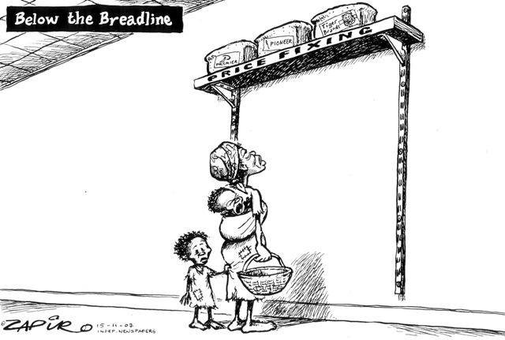
Distributional outcomes
The poor suffer most from price-fixing

Slide 15
Distributional outcomes
Monopolies can create inequality
Cartels and monopoly:
  Raise prices for everyone; and
  Increase income for holders of financial wealth
  Some (over) simple calculations can help quantify the effect of this
Source: OECD 2016

Slide 16
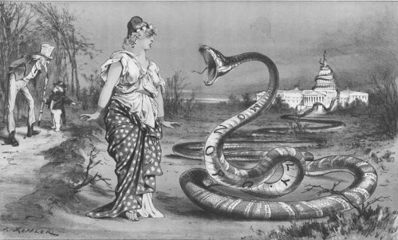
…and it’s not just economic outcomes
Monopolies can corrupt the political process

Slide 17
5. Some ‘small country’ considerations

Slide 18
Small country considerations?
The basic principles and evidence apply, in all countries. There is anyway a ‘continuum’ of countries – UK significantly smaller than the EU!
A few things to bear in mind:
  Important to preserve what little competition there is:
    do not adjust ‘structural presumptions’ to allow e.g. a 3-2 merger that a larger jurisdiction would not allow
    tough action against excluding competitors
  Importance of distribution rights for importers?
  Government constraints on competition might be particularly important – significant advocacy role
  Collusion might be easier to sustain without explicit communication
  Freeing up international trade and investment likely to have particularly strong effect on competition
  … leading to a dualistic economy in which sectors exposed to international competition and sectors protected from such competition behave differently – the latter should be the focus

Slide 19
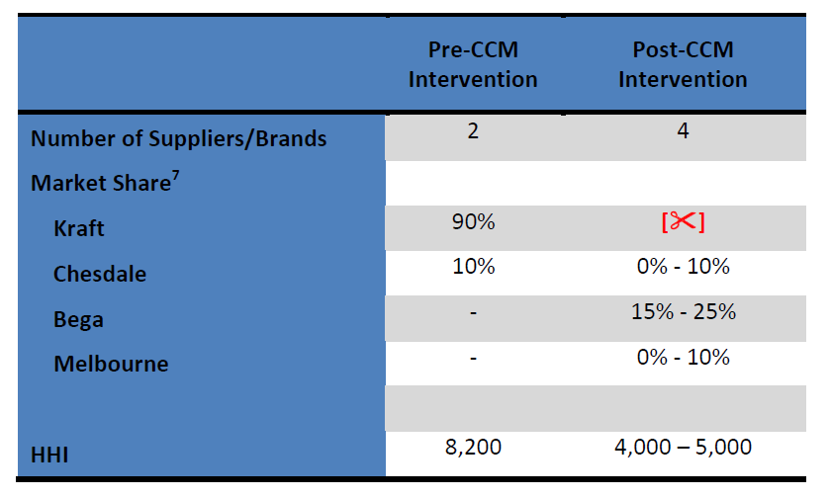
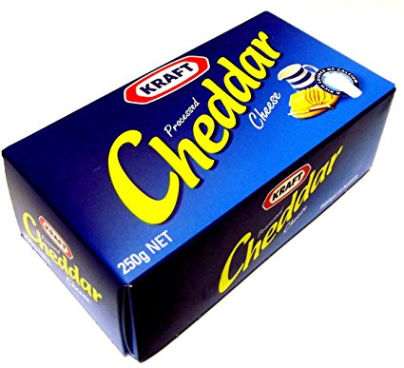
Encouraging entry is more important than anything else
Competition Commission of Mauritius very first case launched late 2009: abuse of dominance by importer of Kraft cheese
Commission found the importer to be in breach, ordered renegotiation of agreements with supermarkets, 2011.
A review of the case, two years later, found that two new entrants had appeared, capturing significant market share.

Slide 20
The international dimension is crucial
  Open developing economies uniquely exposed to international cartels, as we have seen
  Prosecute on basis of effects following investigations at global level
  Developing countries especially need to put pressure on competition agencies to speak out against export cartels:
    Between 2011 and 2020, Chinese consumers will have paid an average overcharge of USD 900 million a year as a result of the potash export cartel. India’s situation is even worse: average overcharge USD 1.17 billion per year. Jenny (2012)
    Jenny observed that if India continued its annual potash subsidy to poor farmers of USD 1.5 billion, between 80% and 100% of that subsidy would serve only to pay for the monopoly rent that the potash cartelists are collecting.
  Regional enforcement – eg CARICOM, EU, WAEMU, COMESA – are a good way to overcome the disadvantages of being small (while keeping benefits)
  South-South groupings might be the only hope for further international integration, for the next few years at least… alas.

Slide 21
6. Is globalisation over?
(no)

Slide 22
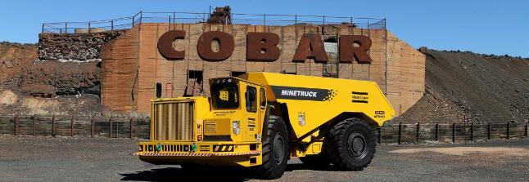
100+ jurisdictions with antitrust law, so global mergers face many hurdles…
Glencore/Xstrata - $90bn combined value
04/2012: Deal proposed
07/2012: Australia and US clear without conditions
11/2012: European Commission clears, if parties sell stake in Nystar (zinc producer)
01/2013: South Africa clears, with some undertakings
04/2013: China MOFCOM clears, if parties sell Las Bambas copper mine in Peru

Slide 23
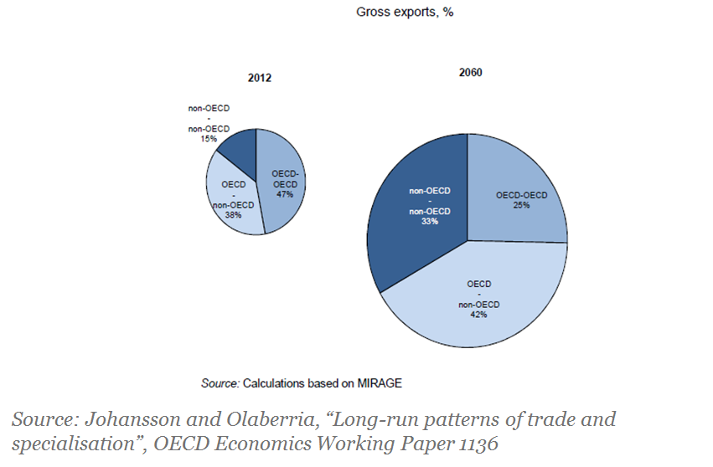
Globalisation still has a long way to go oecd and other projections suggest it has just started
Almost 400% increase in global trade 2012 – 2060, driven by emerging economies
Source: Johansson and Olaberria, “Long-run patterns of trade and specialisation”, OECD Economics Working Paper 1136

Slide 24
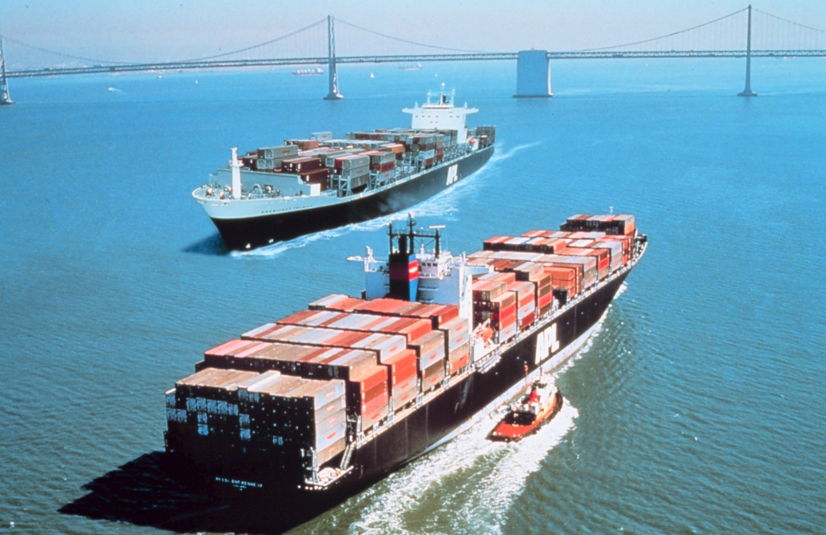
Globalisation still has a long way to go trade growth is driven by technology, not policy
“In other words, containers have boosted globalisation more than all trade agreements in the past 50 years put together. Not bad for a simple box.”
The Economist
Containerisation boosted trade on a bilateral route by 700%
Bernofen (2016)

Slide 25
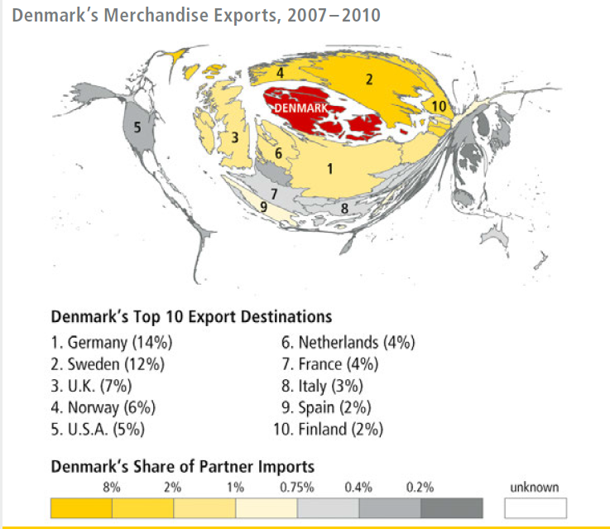
Globalisation still has a long way to go most economies are intensely local
Trade models still find very important distance effects
DHL’s Global Connectedness Index illustrates this in a very effective way!

Slide 26
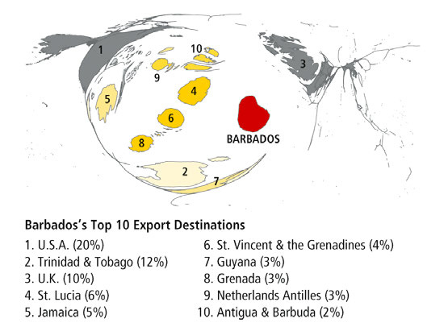
Globalisation still has a long way to go most economies are intensely local
NB: relates only to merchandise exports, so excludes tourism, financial services and doubtless a lot else that is much more important than goods exports!

Slide 27
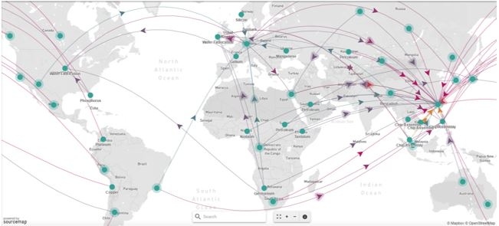
…and with global supply chains we need internationally ‘joined up’ competition policy
How to build a laptop computer

Slide 28

Thank you!
http://www.compasslexecon.com
Notes:
Thank you very much for your attention!

